Slide 1





Big data programming-1
Submitted By:
Ali Mustaq
Anish Umesh
Jasmine Kaur
Narendra Medisetti
Fahmida

Slide 2
SpaCy python library

Slide 3
Introduction
SpaCy is an open-source software library for advanced natural language processing (NLP) in python.
It’s design specifically for production usage and help you build application that process and understand large volume of text.

Slide 4
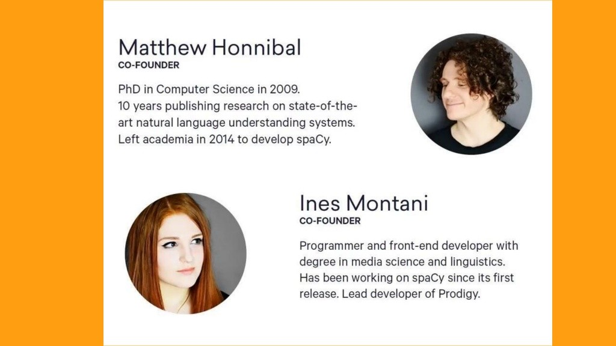
history

Slide 5

Company using spacy

Slide 6
Why use spacy?
Spacy is written to help you get things done. It’s minimal and opinionated. It provides you with exactly one way to do it -- the right way.

Slide 7
Nltk vs spacy
It returns string or lists of string as output. Whereas, spacy use object-oriented approach.
Spacy has support word vectors whereas NLTK does not.
In word tokenization and POS-tagging spacy performs better, but in sentence tokenization, NLTK outperforms spacy.
NLTK support various languages whereas spacy have statistical models for 7 languages (English, German, Spanish, French, Portuguese, Italian, Dutch). It also support name entities for multi languages.

Slide 8
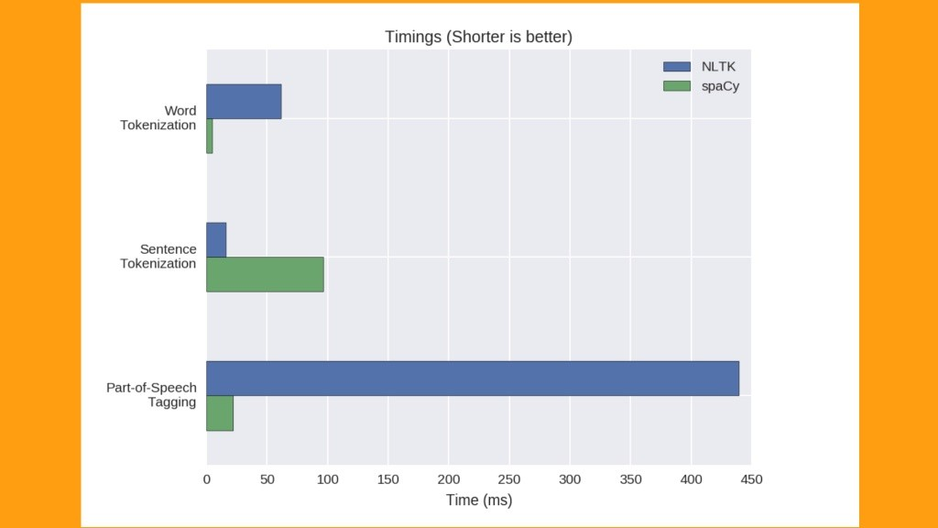

Slide 9
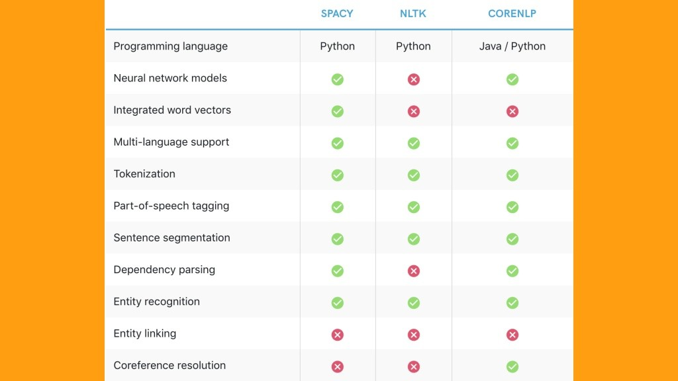
Difference between spacy, nltk and corenlp

Slide 10
lemmatization
Lemmatization is the process of reducing inflected form of a word While still ensuring that the reduced form belongs to the language. This reduced form or root word is called lemma.

Slide 11
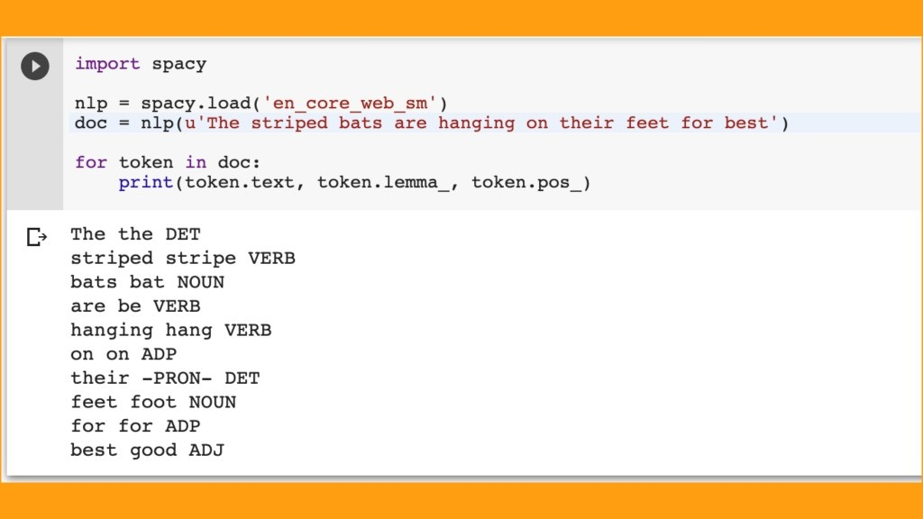
Example 1

Slide 12
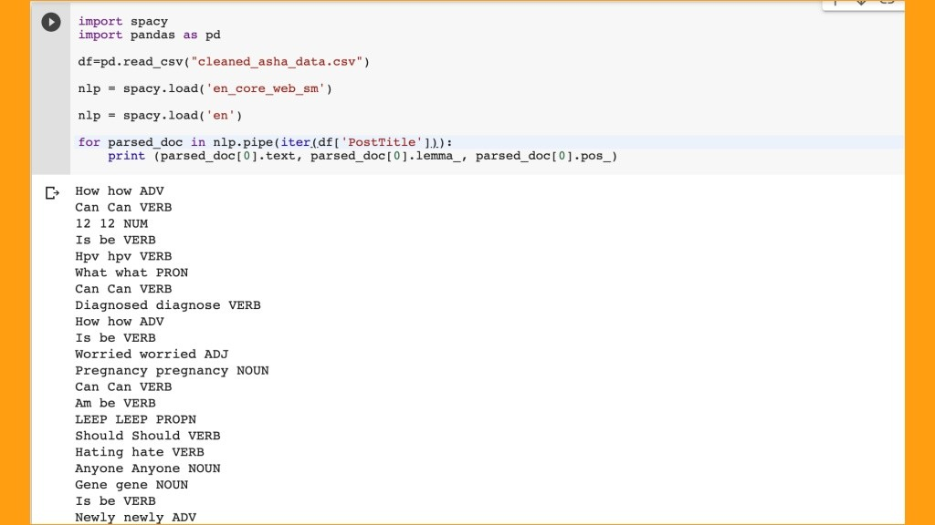
Example 2

Slide 13
Name entity recognition
Name Entity recognition (NER) is a sub- task of information (IE) that seek out and categorise specified entities in a body or bodies text.
NER is used in many fields in Artificial Intelligence (AI) including Natural Language processing (NLP) and Machine Learning.

Slide 14
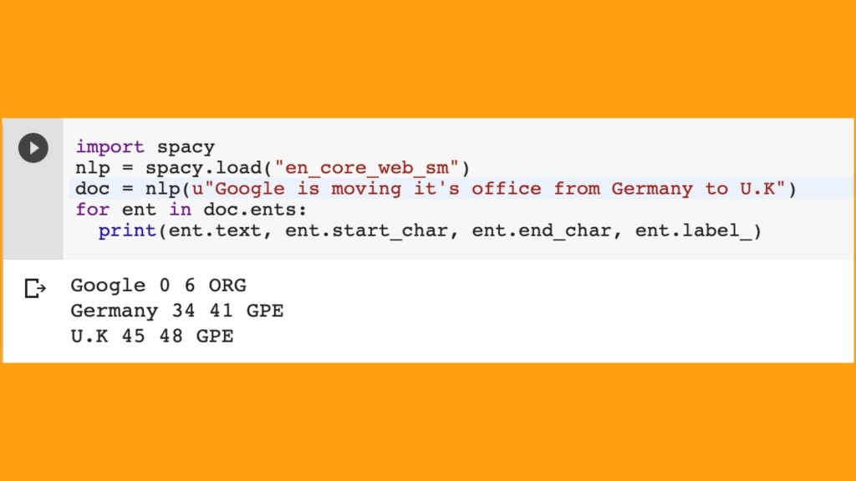
example

Slide 15
Future scope
Sentence tokenization process should be fast.
Spacy should increase language support.
Efficient entity recognition label, Tags.
Media recognition (audio, video, images).

Slide 16
Thinking you

